Slide 1

Module Search Path

Slide 2
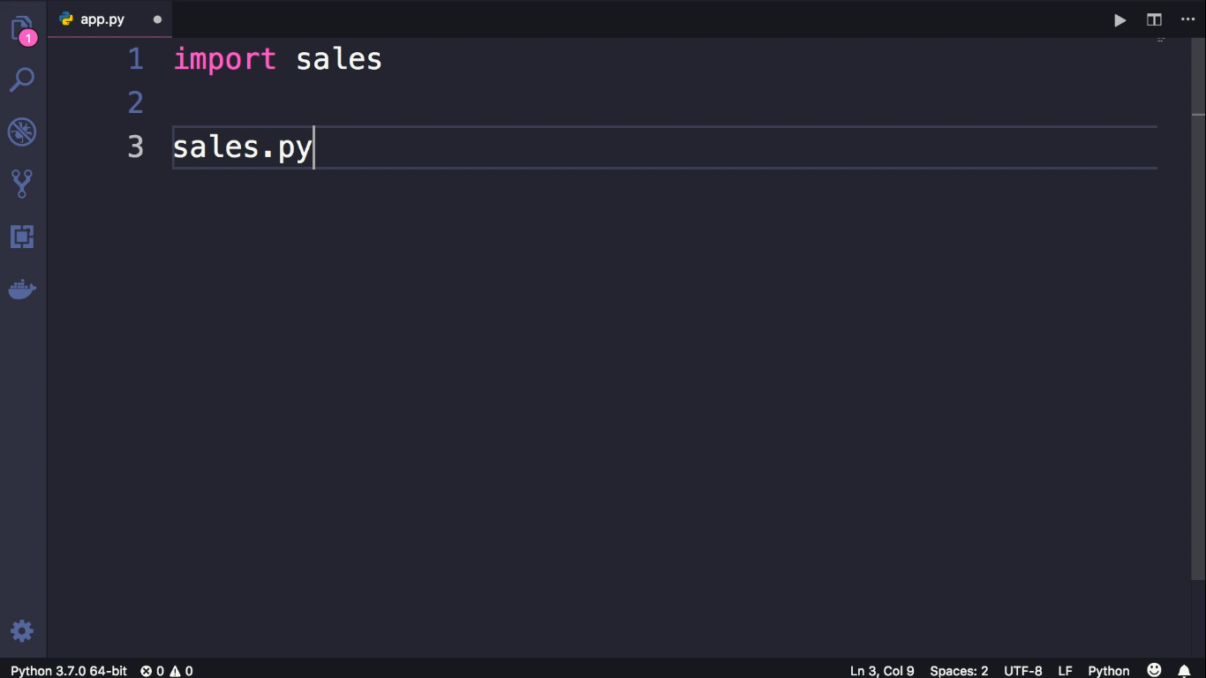

Slide 3
